Slide 1
UNIT 2 PROCESS MANAGEMENT

Slide 2
PROCESS MENAGEMENT
A process is a program in execution.
For example, when we write a program in C or C++ and compile it, the compiler creates binary code. The original code and binary code are both programs. When we actually run the binary code, it becomes a process.

Slide 3
PCB
PCB stands for process control block.
Process Control Block is a data structure that contains information of the process related to it. The process control block is also known as a task control block, entry of the process table, etc.

Slide 4
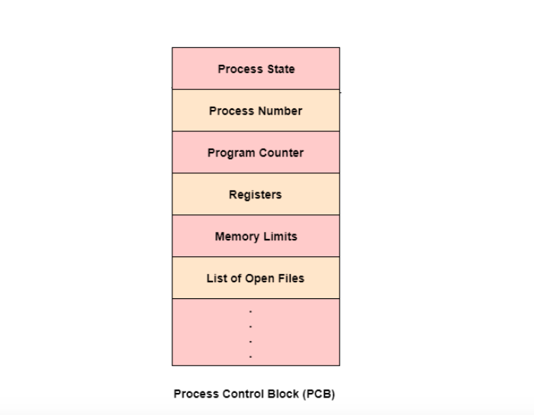

Slide 5
PCB
Process State
This specifies the process state i.e. new, ready, running, waiting or terminated.
Process Number
This shows the number of the particular process.
Program Counter
This contains the address of the next instruction that needs to be executed in the process.
Registers
This specifies the registers that are used by the process. They may include accumulators, index registers, stack pointers, general purpose registers etc.
List of Open Files
These are the different files that are associated with the process.

Slide 6
PROCESS STATES
1. New
2. Ready
3. Running
4. Block or wait
5. Completion or termination
6. Suspend ready
7. Suspend wait

Slide 7
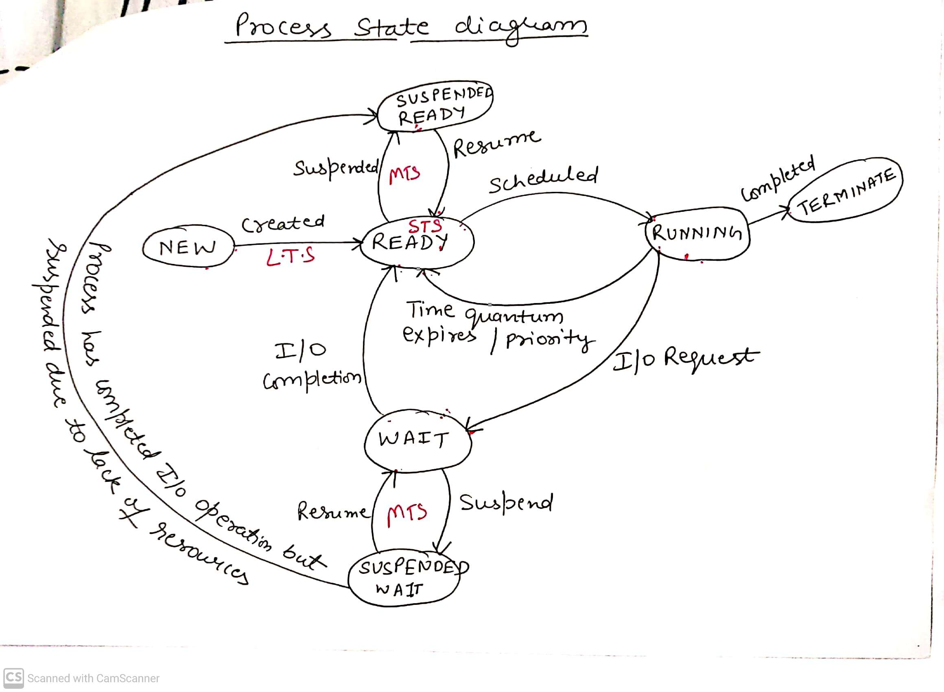
PROCESS STATE DIAGRAM

Slide 8
CPU Scheduling
CPU scheduling is a process which allows one process to use the CPU while the execution of another process is on hold(in waiting state) due to unavailability of any resource like I/O etc, thereby making full use of CPU.
The aim of CPU scheduling is to make the system efficient, fast and fair.

Slide 9
Preemptive and Non-Preemptive Scheduling
Preemptive Scheduling: Preemptive scheduling is used when a process switches from running state to ready state or from waiting state to ready state.
Algorithms based on preemptive scheduling are: Round Robin (RR),Shortest Remaining Time First (SRTF), Priority (preemptive version), etc.

Slide 10
Non-Preemptive Scheduling: Non-preemptive Scheduling is used when a process terminates, or a process switches from running to waiting state.
Algorithms based on non-preemptive scheduling are: FCFS, Shortest Job First (SJF basically non preemptive) and Priority (non preemptive version), etc.

